Slide 1


THE KAVERY ENGINEERING COLLEGE
DEPARTMENT OF MECHANICAL ENGINNERING
ME8811-PROJECT WORK
LUBRICATION OIL TANK LEVEL INDICATOR WITH MAKING CALL ALERT ALONG WITH SMS USING GSM MODULE
Presented by,
SRIDHAR.A -612720114021
KAVIYARASU.S -612720114312
NAVEEN.S.V -612720114318
VINOTH.S -612720114331
Guided by,
Mr. S.DURAISIVAM,M.E.,(ph.d.).,
Assistant professor,
Dept.of Mechanical Engineering

Slide 2
LIST OF CONTENTS:
Abstract
Industry- neel metal products ltd (JBM groups)
Problem identification
Literature review
Existing system
Proposed system
Advantages
Methodology
9. Block diagram
10. Hardware components
11. Software
12. Model and outcome results
13. Cost estimation
14. Future enhancement

Slide 3
ABSTRACT:
Indirect monitoring in industry machinery functions can enhance efficiency by providing real time data on performance and increasing productivity. Lubrication plays a vital role in the smooth operation of machines, preventing wear and tear, and reducing friction. To streamline the lubrication monitoring process, the GSM-based Call and SMS Alert Lubrication Level Indicator project has been developed. In our project, implemented with Arduino Nano, aims to revolutionize industrial machinery maintenance by providing a real-time monitoring and alert system for lubrication oil level

Slide 4

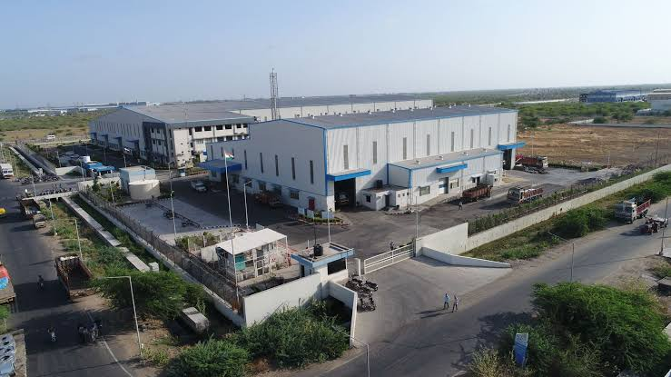
INDUSTRY INTRODUCTION:
NEEL METAL PRODUCTS LTD (JAY BHARAT MARUTI LTD)-HOSUR

Slide 5
ABOUT JBM-NEEL METAL PRODUCTS LTD:
JBM Group of company chairman S.K ARYA. In 1983 the organization commenced operations as a manufacturer of LPG Cylinders for the Delhi-NCR region of India.
JBM Group entered into the automotive industry in 1985.
The Group has a diversified portfolio to serve in the field of automotive, engineering & design services, renewable energy and education sectors and has an infrastructure of 63 manufacturing plants, 4 engineering & design centres across 18 locations globally in 10 countries.
JBM Group is primarily a tier- 1 supplier to the automotive OEM industry and caters services to esteemed clients that include Ashok Leyland, Bajaj Auto Ltd, Fiat, Ford, General Motors Corporation, Honda, Hero, JCB, Mahindra, Maruti Suzuki, Renault, Nissan, TATA, Toyota, TVS, Volvo-Eicher, Volkswagen
In hosur plant they mainly manufacture automotive body frames, muffler, silencer, different fuel tank.

Slide 6
PROBLEM IDENDIFICATION: [ press section]
Real-time monitoring functions , Security and privacy
Sensor Integration, Data interpretation
Maintenance planning for large number of machineries.
JBM Requirement for Lubrication oiI Monitoring in Hydraulic press:
In JBM Industrial machinery relies heavily on proper lubrication to ensure smooth and efficient operation to reducing friction, dissipating heat, and preventing wear and tear on moving parts.
Equipment Damage
Downtime and Production Loss
Safety Concerns , Increased Maintenance Costs

Slide 7
LITERATURE REVIEW :
In 2011,This paper describes tank water level monitoring system using GSM netwok.
In 2014, This paper represents that smart water tank management system using Atmega128 microcontroller
In 2015, This paper represents that Smart water monitoring system using wireless sensor network.
In 2018,This paper represents that Smart liquid level controller using arduino with sms alert
ln 2023, This paper proposes GSM based industry protection system.

Slide 8
EXSISTING SYSTEM :
In 2011 - tank water level monitoring system using GSM netwok.
In 2014 - smart water tank management system using Atmega128 microcontroller
In 2015 - Smart water monitoring system using wireless sensor network.
In 2018 - Smart liquid level controller using arduino with sms alert
Till up to date existing only water level monitoring system with making sms alert system

Slide 9
PROPOSED SYSTEM:
In our project aims to introduce an intelligent and remote monitoring solution that leverages advancements in microcontroller technology and GSM communication.
By utilizing an Arduino Nano microcontroller and the GSM SIM800L Module, the system provides real-time insights into lubrication oil levels and employs a proactive alert system through phone calls and SMS notifications
This proactive approach to lubrication level monitoring aims to prevent potential damage to machinery due to inadequate lubrication.

Slide 10
CONCEPT ADVANTAGES :
Real-time Monitoring
Proactive Maintenance
Compact and Versatile Design
User-friendly Configuration
Cost-Effective Solution
Reduced Downtime
Remote Monitoring Capability
Contribution to Preventive Maintenance Practices

Slide 11
METHODOLOGY:
Hardware Connection
Software Coding for Arduino Nano
GSM Module Integration
WORKING PRINCIPLE:
The GSM-Based Call and SMS Alert Lubrication Oil Level Indicator operates through a systematic interaction between the lubrication level sensor, Arduino Nano microcontroller, and GSM SIM800L Module
Lubrication Level Sensing
Arduino Nano Processing
Gsm Module Activation
Feedback And Monitoring

Slide 12
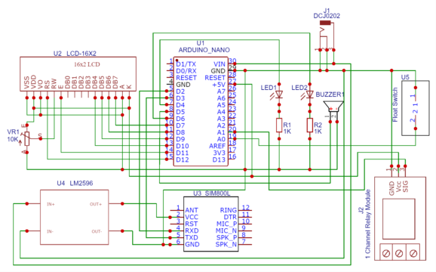
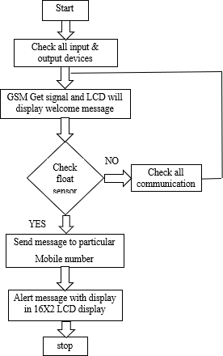
BLOCK and CIRCUIT DIAGRAM:

Slide 13
HARDWARE :
Arduino Nano
GSM module SIM800L
Liquild level float sensor
LM2596 buck converer
16*2 LCD Display
Buzzer,led light
Resistors(560 ohm),potentiometer

Slide 14
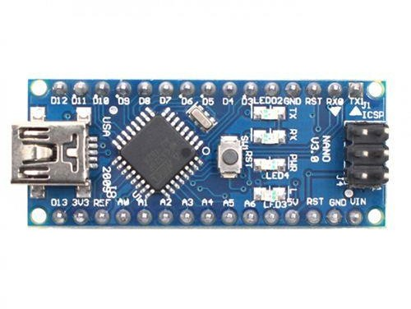
ARDUINO NANO:
The Arduino Nano is an open-source breadboard-friendly microcontroller board based on the Microchip ATmega328P microcontroller (MCU) and developed by Arduino.cc and initially released in 2008.
The Arduino Nano is equipped with 30 male I/O headers, in a DIP-30-like configuration, which can be programmed using the Arduino Software integrated development environment (IDE), which is common to all Arduino boards and running both online and offline

Slide 15
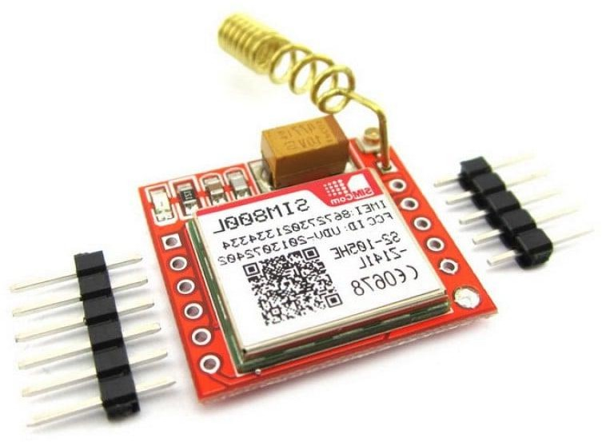
GSM module SIM800L:
The SIM800L module is a reliable and efficient solution for adding cellular connectivity to devices such as IoT devices, alarms, remote controls, and more.
The SIM800L GSM module is small in size, low in power consumption and easy to integrate into any system with its UART and ADC interfaces

Slide 16
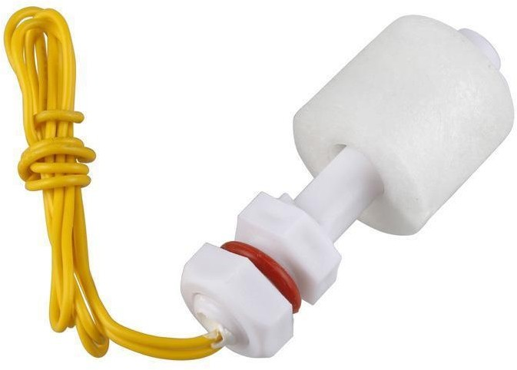
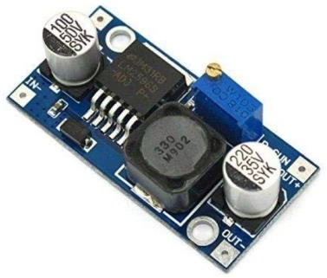
Liquid Level Float Switch:
Float switches are commonly used to control other devices such as alarms and pumps when a liquid level rises or falls to a specific point.
LM2596 buck converter:
The LM2596 is a type of voltage regulator, specifically a step-down (buck) converter. It is an integrated circuit that provides the necessary functions for converting a higher input voltage to a lower output voltage.

Slide 17
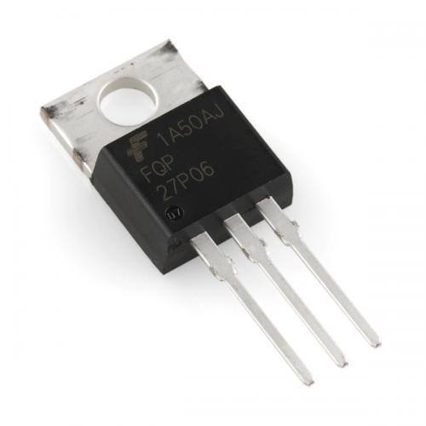
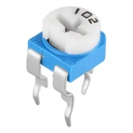
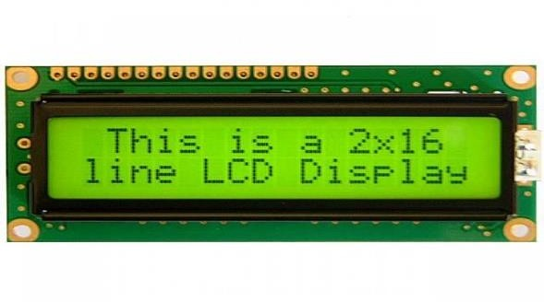
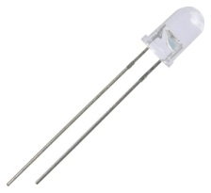
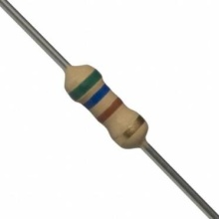
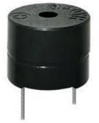
SUPPORTING COMPONENTS:
Voltage regulator lm 7805 IC
Potentiometer (10K PORT)
16X2 LCD module:
Buzzer ,LED Lights and 560 ohm resistor

Slide 18
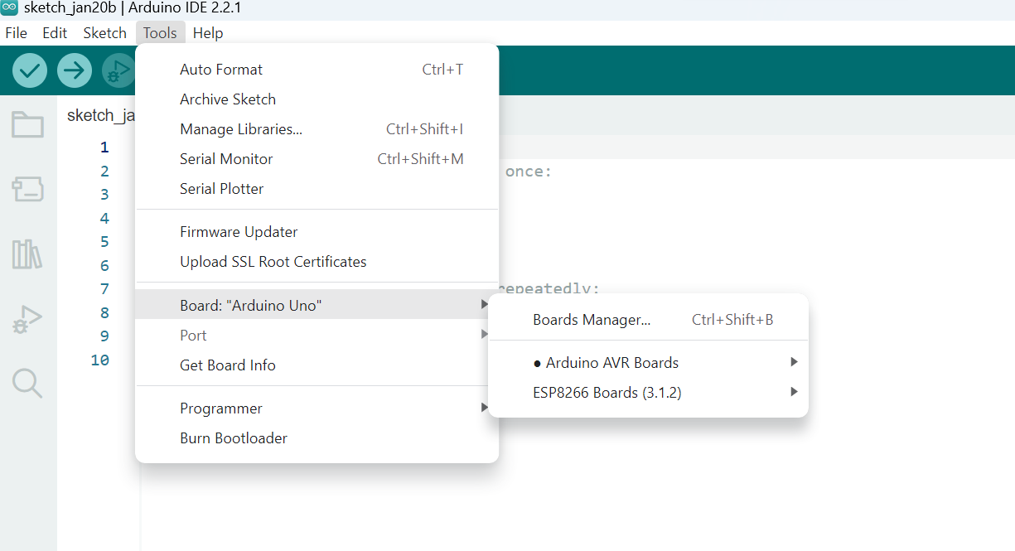
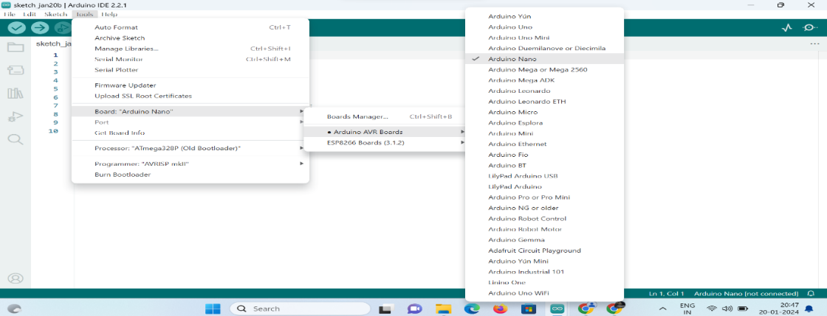
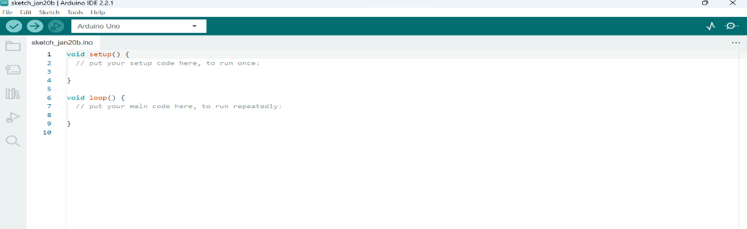
SOFTWARE :
Arduino integrated development environment (IDE) with cp2102(Version 2.2.1)
Program language basic C++

Slide 19
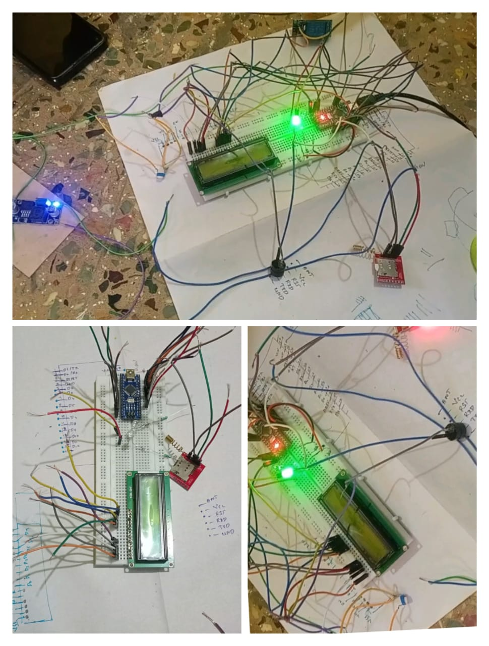
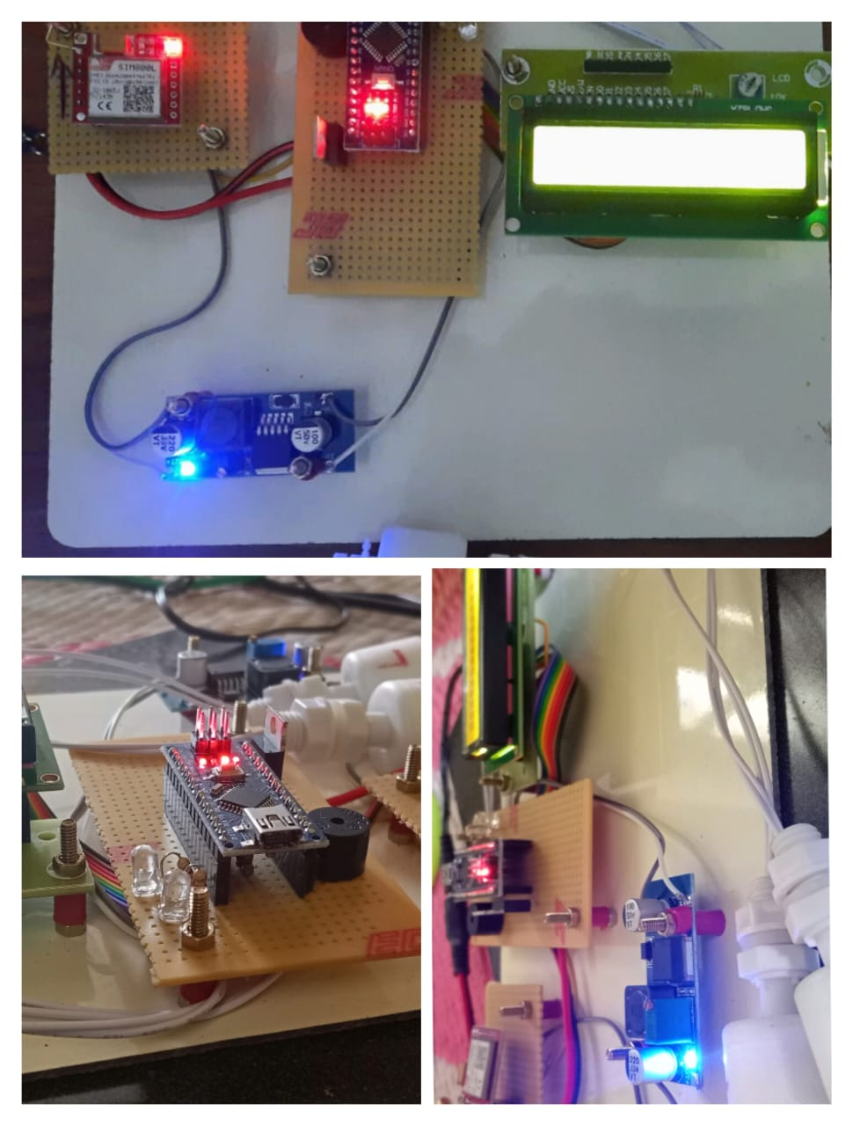
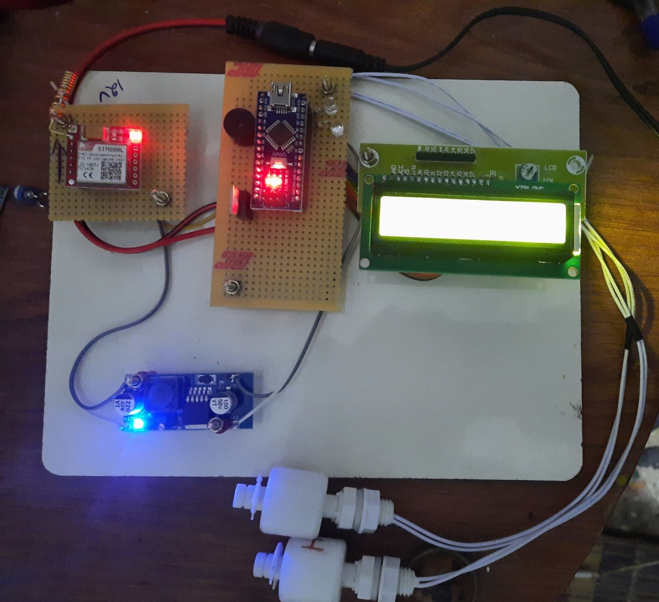
PROTOTYPE MODEL AND OUTCOME RESULTS:

Slide 20
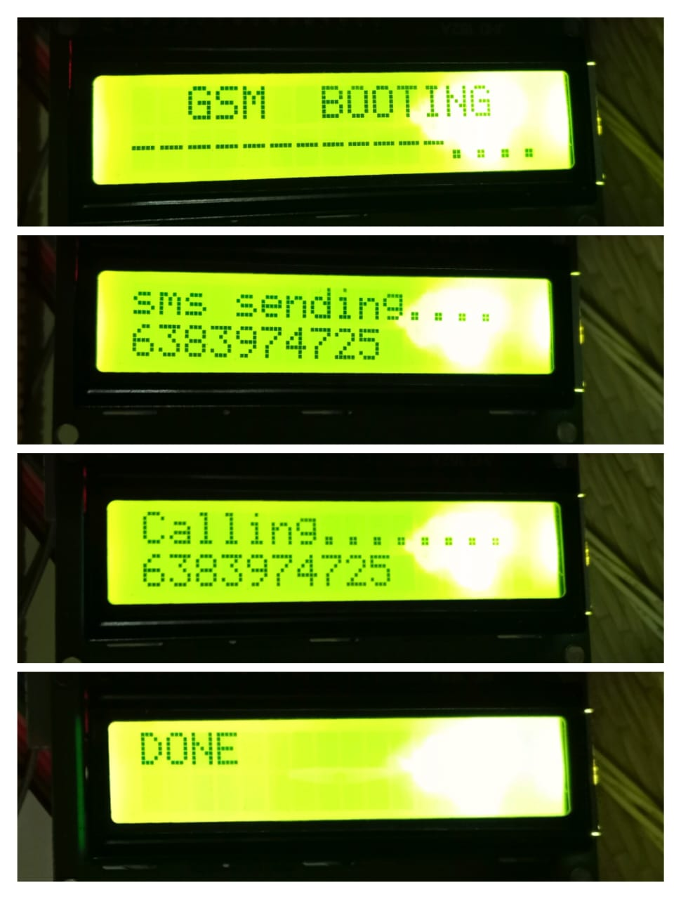


IN INDUSTRY TESTING OUTCOME

Slide 21
COST ESTIMATION:
S . No | Name of component | Quantity | Cost
1 | Arduino nano ch340 | 1 | 300
2 | LM2596 Buck convertor | 1 | 50
3 | GSM 800l module | 1 | 300
4 | 16*2 LCD display | 1 | 120
5 | PCB Board | 1 | 50
6 | Float sensor | 2 | 300
7 | Jumper wire | 2 | 40
8 | 10 k port | 1 | 5
9 | 5 mm LED Bulb (R &G) | 2 | 4
10 | buzzer | 1 | 15
11 | Plain board | 1 | 50
12 | Connecting bolts | 8 | 10
13 | Regulator lm7805 IC | 1 | 5
14 | Resistor 560 ohm | 3 | 8
TOTAL |  |  | 1257

Slide 22
FUTURE ENHANCEMENT:
Our project concept will implement 63 jbm plants in india.
Predictive Maintenance with Machine Learning:
Auto sensing Implement machine learning algorithms to predict lubrication issues , Pressure fluctuations ,Temperature Control , Component wear, Safety systems , Data logging and analysis , remote monitoring.

Slide 23
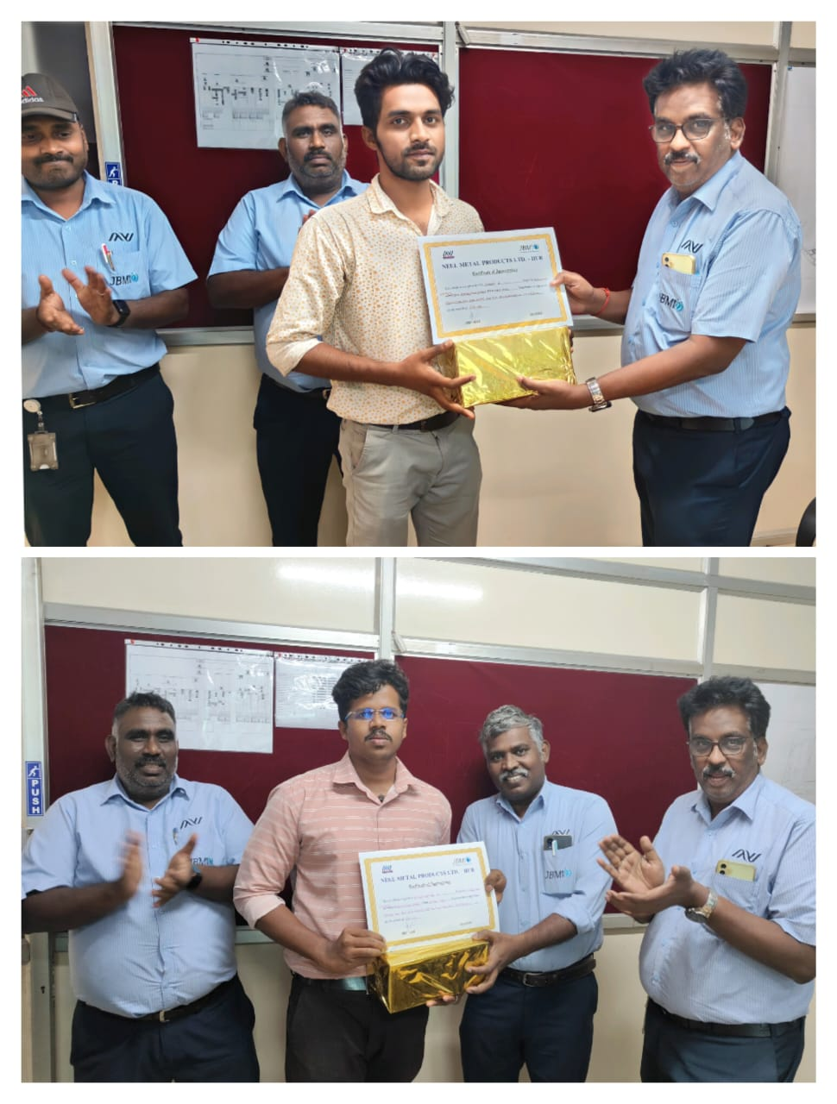
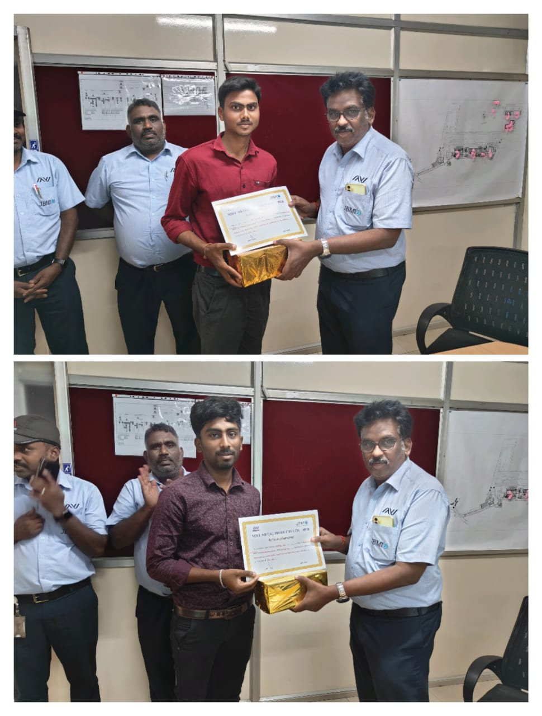
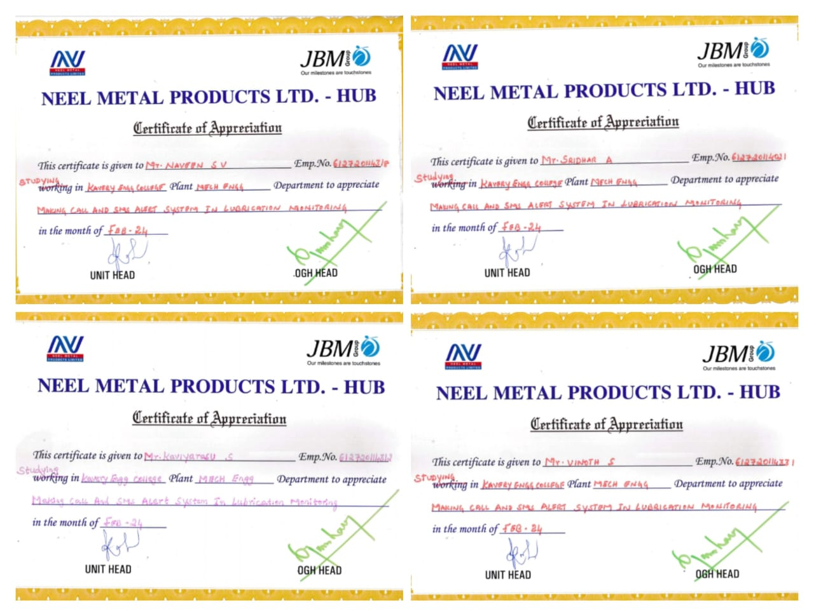
OUR PROJECT RECOGNITON BY JBM PLANT HEADS

Slide 24
THANK YOU

